Slide 1
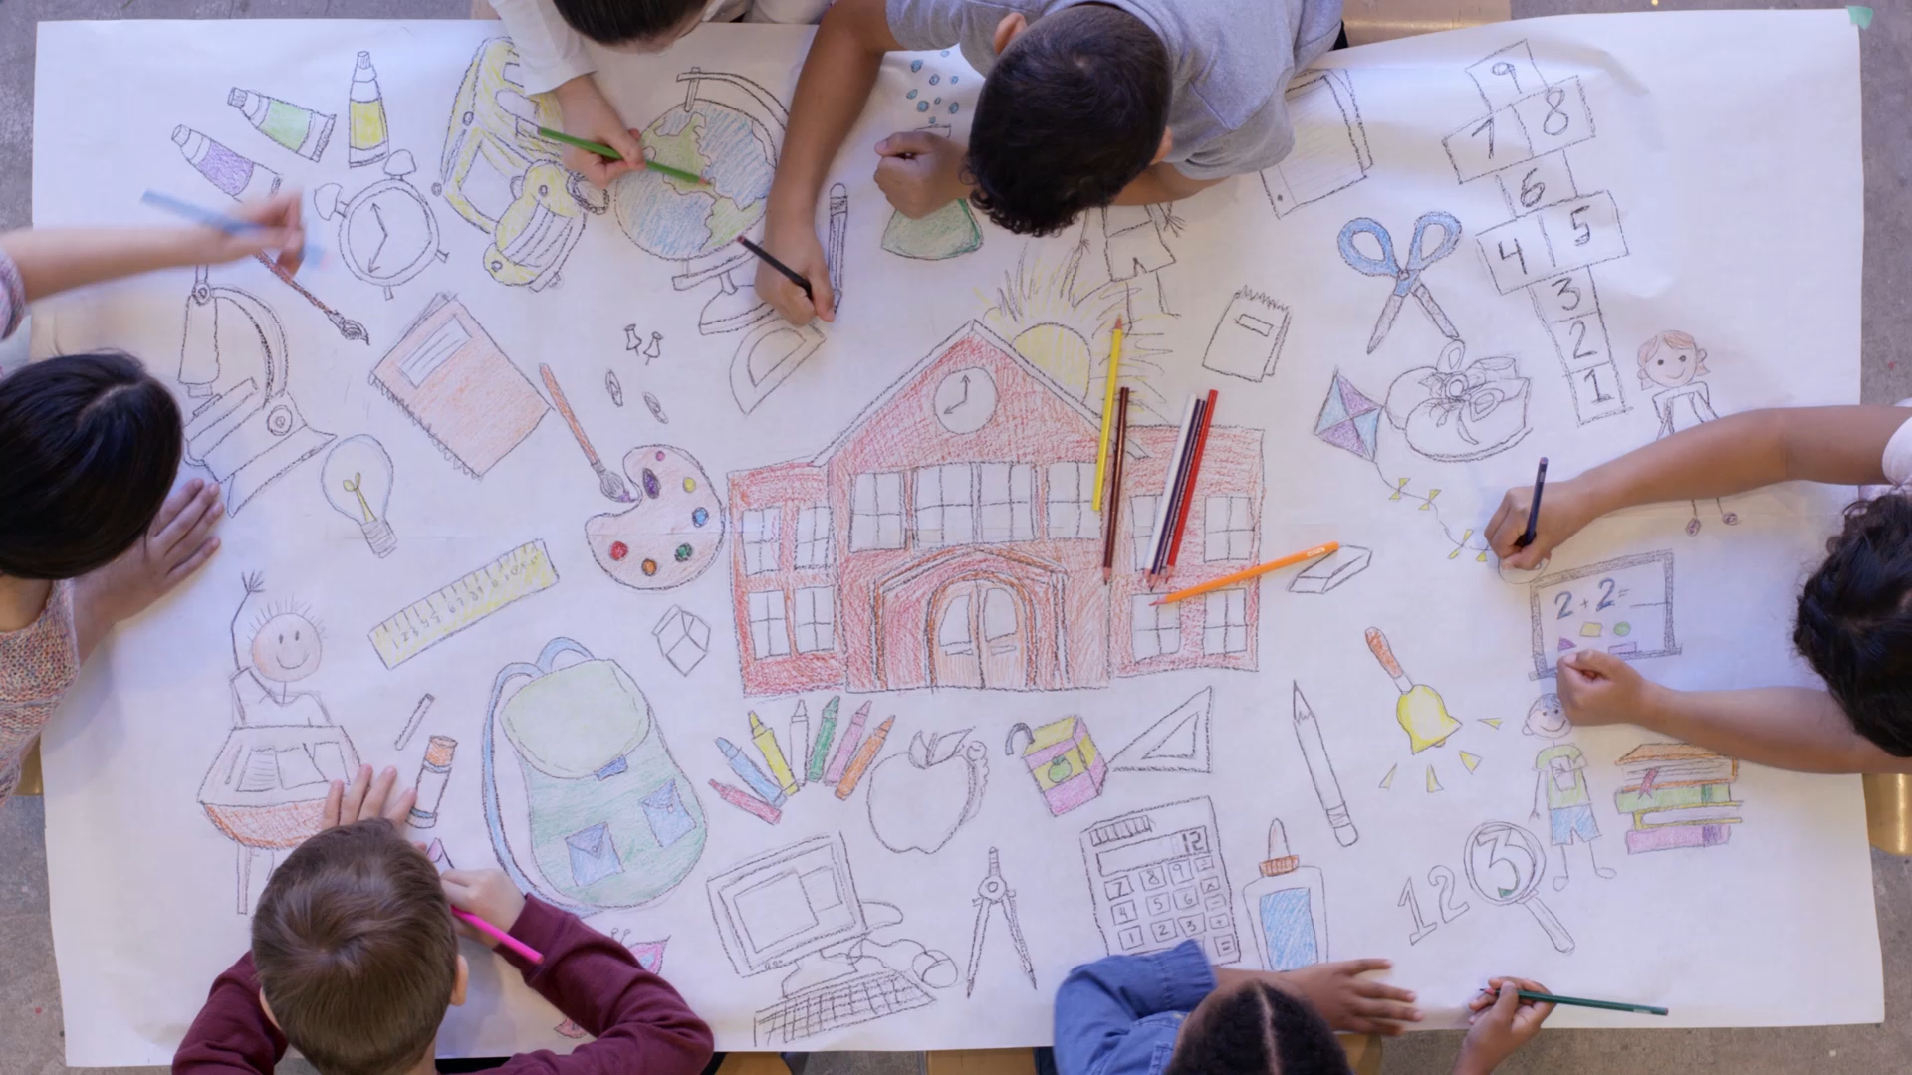
WELCOME TO CHESTNUT CLASS!

Slide 2
TONIGHT:
Entering and Leaving
Food Choices
Water Bottles and Toileting
A Typical Week
Plan for the Year
Communication
Behaviour
PE
Reading
Homework

Slide 3
ENTERING AND LEAVING
Building gate opens at 8.45am.
Children will be outside for pick up at 3.15pm.
8:55 AM
8:45 AM
3:15 PM
The children are registered at 8.55am.

Slide 4
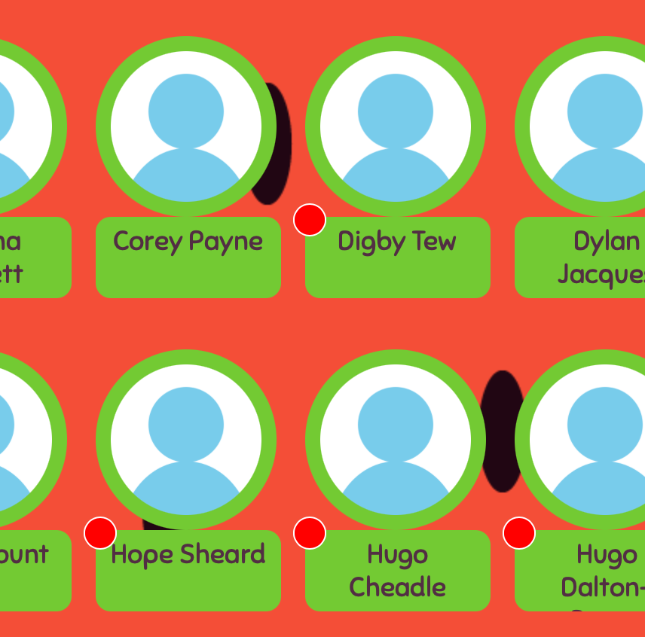
FOOD CHOICES
Online ordering system (via parentpay).
Pre-order food for your child for the week+.

Slide 5
WATER BOTTLES AND TOILETING
Children have full access to a drink whenever they want it.
Water/flavoured water during class time.
Squash/coloured water/juice during break and lunch times.

Slide 6
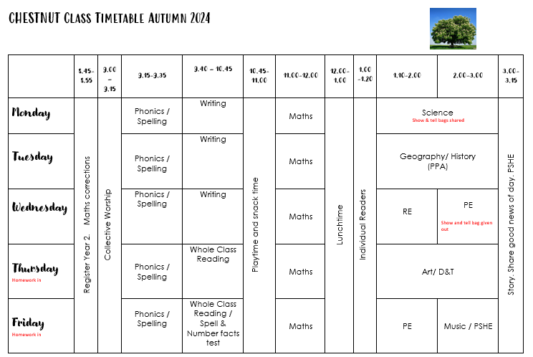
A Typical Week

Slide 7

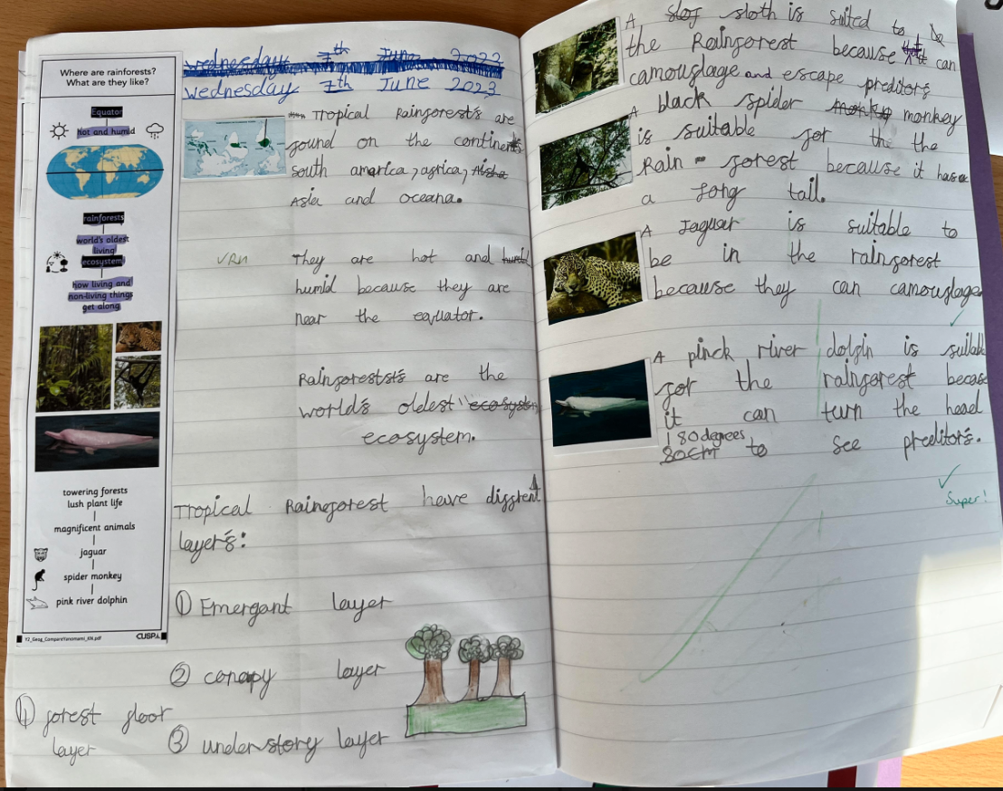
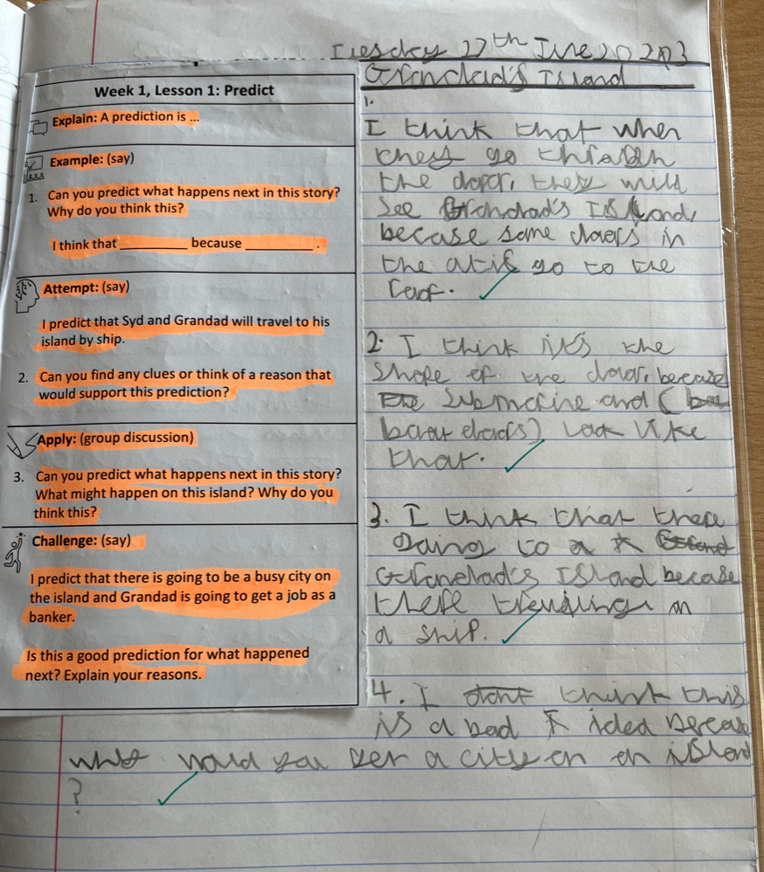
CUSP Curriculum

Slide 8
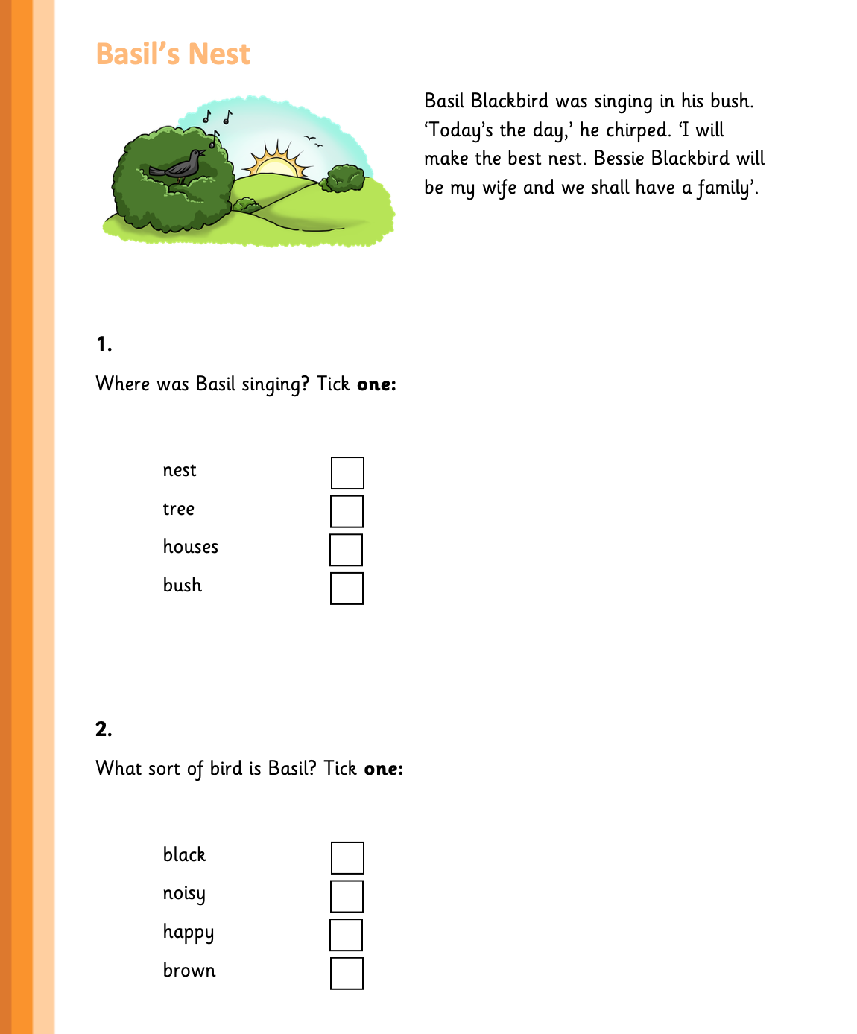
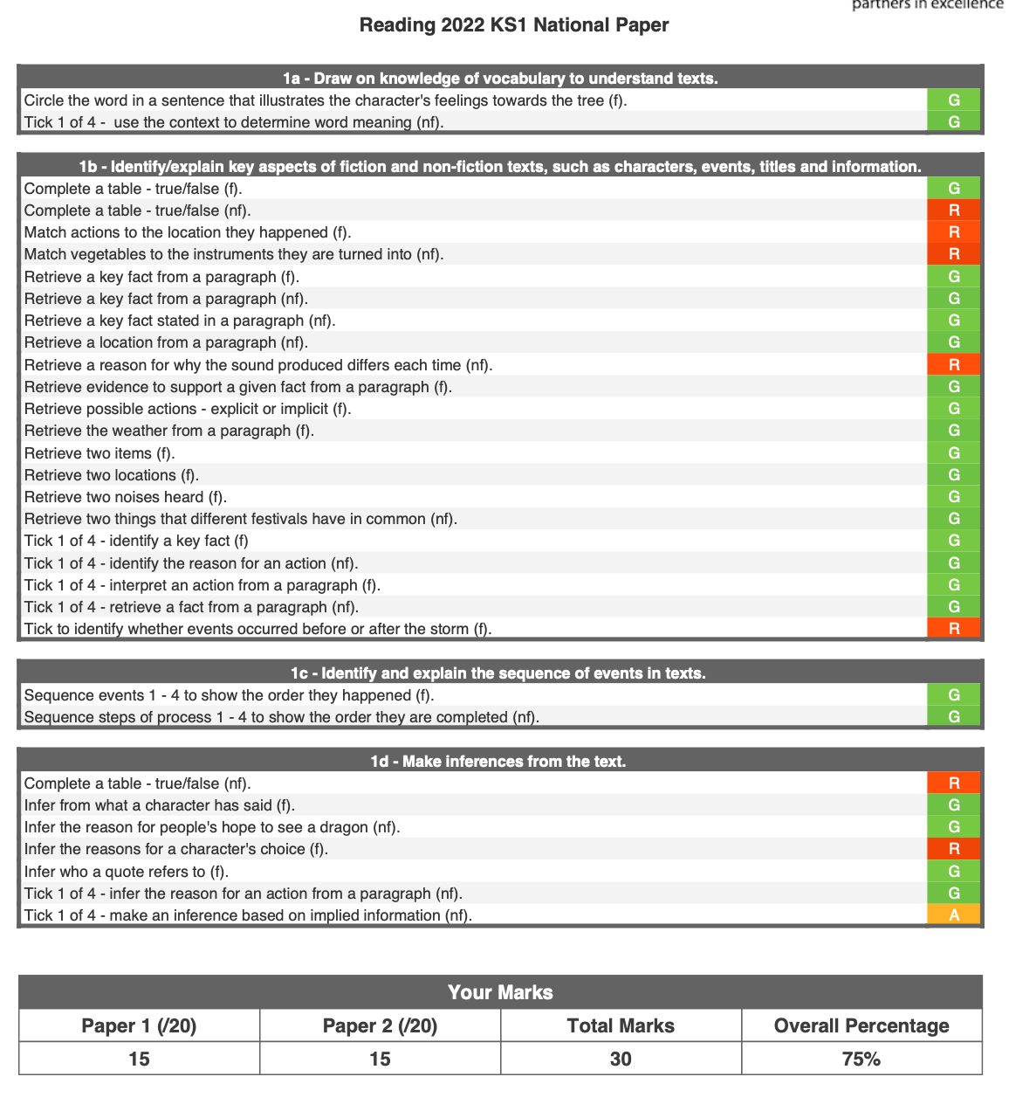
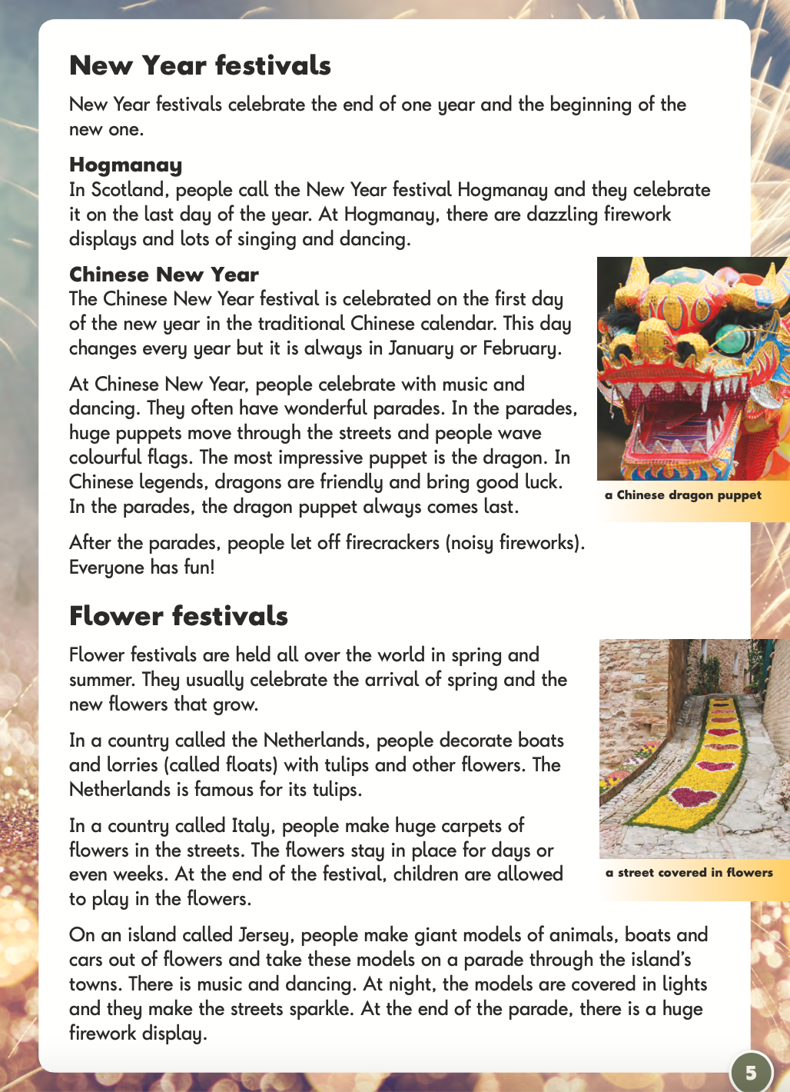
PiXL Assessment
Notes:
Year 1 SUmmer Term Assessment

Slide 9
COMMUNICATION
Home school diaries
Website
Facebook
Newsletters
Handouts (i.e., curriculum letters)

Slide 10
A WEBSITE WALK THROUGH
Resources posted to support home/school learning.

Slide 11

BEHAVIOUR (1)
Recognition Board
Stickers
Pompoms= Whole Class Reward!
Head Teacher Recognition

Slide 12
BEHAVIOUR (2)
Simple reminder (look)
Simple reminder (verbal)
Caution
Last chance (scripted conversation)
Time out (yellow card)
Repair (talk of improvement)
Time out (red card)

Slide 13
PE
Full kit: black bottoms, white top, trainers and a black hoodie.
Micropore tape for earrings
Hair tied back
Wednesdays and Fridays

Slide 14
READING
Children will practice comprehension skills with class teachers (at least) once a week.
Shared class reading with class books/novels.
Daily phonics sessions.
Reviews of home reading books.
Termly assessments.
Children to read at home x3 weekly.
On Friday’s we will do a reading record check.

Slide 15
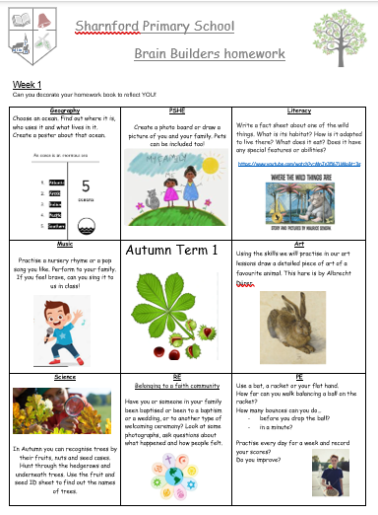
HOMEWORK
Must Do’s:
Please read regularly with your child – 20 mins three times a week is ideal – fluency does not equal good comprehension; check they are understanding what they have read.
30 minute Maths or English task each week. This will be either spellings or number facts and we will assess them weekly on these on a Friday. 6 minutes a day practice is better for memorizing facts than a once a week run through.
Times tables should also be practiced regularly – TT Rock Stars (Year 2)
Optional:
Brain Builders – activities linked to the wider curriculum – enjoy the opportunity to work with your child but also encourage your child to be independent too! These will be sent half termly.

Slide 16
HOME/LINK
A KS1 adult will be on the gate to greet and send off children.
Should you need to pass on any messages, you can do so via the adult.
Should it be something of more significance (i.e. concerns, requesting a meeting with class teachers) please email the office and we will respond and/or organise this as soon as possible.

Slide 17
THANK YOU FOR YOUR TIME.
If you have any questions or queries then please speak to myself afterwards or email the office.

