Slide 1

Read Write inc. Phonics
A quick parents guide to your child’s early reading.

Slide 2
Purpose of the meeting…
Phonics language
Introduce you to FRED
Assessment
Reading at home
Speed Sounds and Letter Formation
Notes:
Phonics language- to introduce you to some key terms that your child will hear- e.g. phonemes, graphemes, special friends
Introduce you to FRED- a puppet that helps us to learn our sounds
Phonics lesson- model a short version of a typical lesson your child will have daily
Letter formation- pictures and rhymes (such as mazey mountain mountain) to support early letter recognition and formation
Assessment- we will assess your child’s early reading and letter knowledge which will inform home reading
Home Reading- what you can do to support your child’s early reading.

Slide 3
Phonics language:
Key words and phrases that your child will hear throughout the year.
Phoneme: the pure sound (m, a, s, d)
Grapheme: the written sound
Special Friends: a combination of two or three letters that make one sound
Segment: split the word into individual sounds
Blend: to say the sounds together fluently to create the word
Fluency: pace within reading
FRED Talk: refers to segmenting and blending the words for reading
FRED Fingers: segmenting the sounds in a word to spell
Notes:
Please note- children are not immediately fluent, it’s all about practice, the more they practice recognising, segmenting and blending sounds, the more fluent they will become and will be able to read harder texts with trickier words.

Slide 4

Speed Sounds
Learn a sound a day.
Reviewing all sounds learnt daily.
This leads into ‘FRED Talk’ and ‘FRED Fingers’ once the children have learnt the first five sounds.
Notes:
Demonstrate the process of learning the speed sound.
Make clear that children need to know the sounds not the names- we also must be careful that they are pure- without a shwar-i.e. ‘m’ not ‘muh’

Slide 5
Learning the Speed sounds:
Say the Sound:
Stretchy or bouncy sound?
Hold up the picture card
Read the Sound:
Learn the phrase,
Learn the grapheme (letter),
Flip between the phrase and the letter
Review the Sounds:
Go through all the sounds learnt in their set so far.
Write the letter:
Air write
Practice on boards and in books
Speed Write:
Practice writing letters previously learnt
Notes:
Model process.

Slide 6

Teaching letter formation

Slide 7

Meet fred…

Slide 8
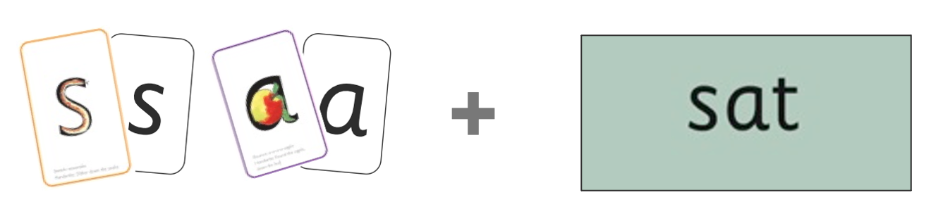
FRED…
FRED will teach the children how to read and spell. He can say the segmented sounds, but he cannot say the whole word.
This is where the children must help FRED.
E.g., The word ‘sat’. FRED would say:
‘s-a-t’.
The children will help FRED to blend the segmented sounds together to read the whole word- sat.

Slide 9
FRED…
FRED Talk:
Blend orally (without speed sound cards).
Blend orally (with speed sound cards)
Magnetic sounds
FRED Fingers:
Non-dominant hand for ‘fingers’ and their dominant hand for ’pinching’ the segmented sounds.
Notes:
FRED Talk:
Key that children look for special friends first and then FRED talk.
Blend orally (without card): “I can see a c-a-t. C-a-t.” Children can jump in if they know how to blend the sounds to make the word.
Blend orally (card): modelling reading the sound and blending- encouraging children to tell us the sounds they need.
Magnet sounds: children make the word, i.e., c-a-t. independently having a go at creating the same words practised before.
FRED Fingers:
Done once the children are blending independently

Slide 10
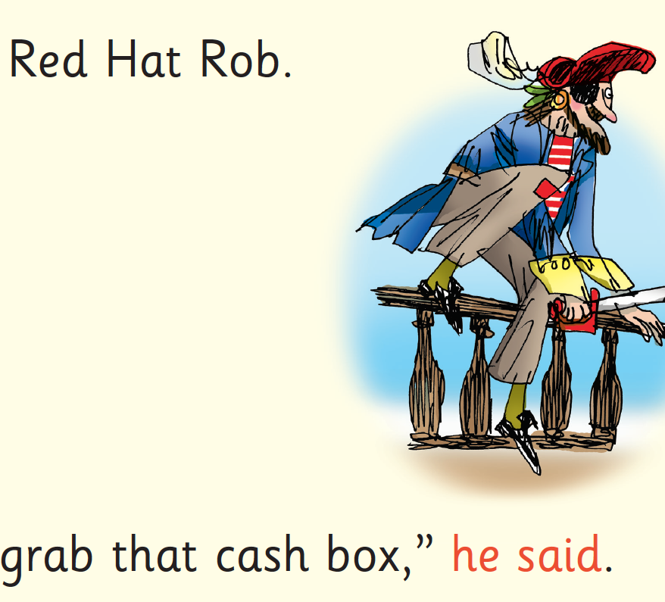
Red words
Some words are ‘tricky’ because they contain letters that don’t match the sounds the child has been taught.
For example, ‘said’ has ‘ai’ making an ‘e’ sound.
We teach these common exception words as ‘Red Words’.
In the early Storybooks, these words are printed in red text.
Remind your child not to use Fred Talk to read Red words but instead to stop and think. Tell them the word if needed.
Notes:
We will also send home some common exception words for you to practice.

Slide 11
Assessment
Each term we will assess your child on their phonic knowledge.
We carefully match your child’s phonic level to a home reading book.

Slide 12
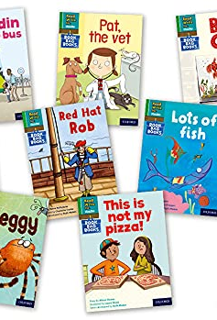
Reading at home
Your child will have a book to take home. Initially this may be a picture book. Either way this is an opportunity to develop comprehension through discussing the pictures, characters, potential plot, etc…
Once the children are secure with blending (supported with assessment) the children will have books to match their phonic level.
Notes:
Please note:
The books sent home are designed to be easy and for children to be fluent. This will aid confidence as well as a pleasure for reading. This reinforces sounds that have been learnt within school.
It should not be difficult nor should they need constant support- if they hesitate please remind them to read the words using special friends and FRED talk.

Slide 13
Read, Read, Read!
https://schoolreadinglist.co.uk/reading-lists-for-ks1-school-pupils/100-best-picture-books-to-read-before-you-are-5-years-old/
It is so important to read for pleasure with your child – see our list of recommended reads in the link above.

Slide 14
TOP tips:
Make it a treat – introduce each new book with excitement.
Make it a special quiet time – cuddle up!
Show curiosity in what you’re going to read.
Read story once without stopping so they can enjoy the whole story. . If you think your child might not understand something say something like ‘Oh I think what’s happening here is that…”
Chat about the story e.g. I wonder why he did that? Oh no, I hope she’s not going to…
Avoid asking questions to test what they remember.
Link to other stories and experiences you have shared e.g. this reminds me of…
Read favourites over and over again – encourage your child to join with the bits they know. Avoid saying ‘not that story again!’
Use different voices – be enthusiastic!
Love the book – read with enjoyment.

Slide 15
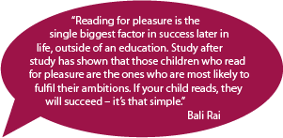

Slide 16
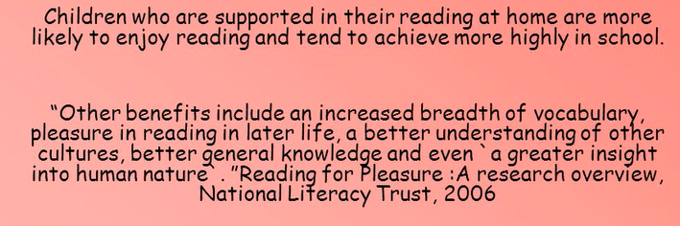
Reading For Purpose and pleasure…

Slide 17
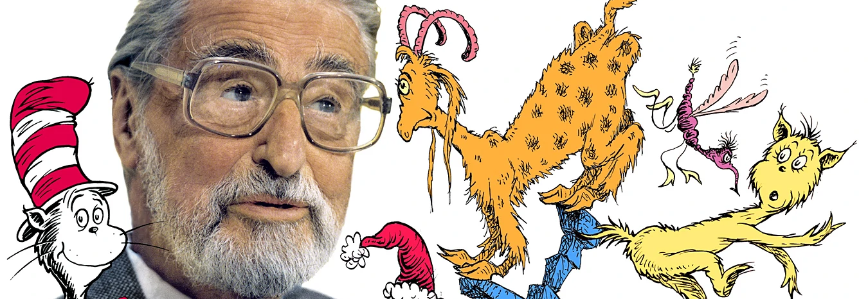
The more that you read, the more things you will know. The more that you learn, the more places you’ll go! Dr seuss.

