Slide 1


DESIGN & TECHNOLOGY
Inspiring innovation in an ever-changing world.

Slide 2
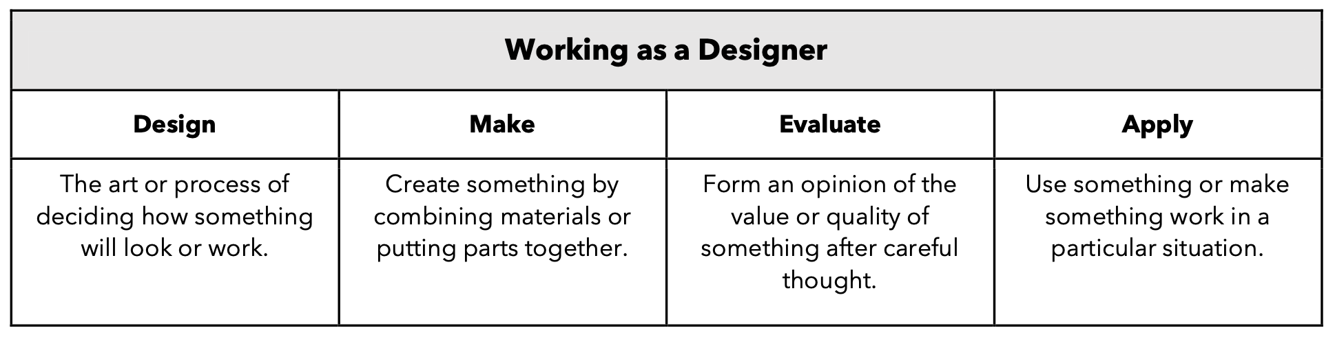

CUSP Design and Technology is purposely built around the principles of evidence-led practice. This is to ensure that pupils are equipped to successfully think, work and communicate like a designer. Unapologetically ambitious, our curriculum focuses on excellence in this subject through a range of disciplines and by referencing outstanding practitioners in this field.
The intention is that the exceptional teacher instruction inspires pupils to acquire knowledge as designers and technologists and enables them to skilfully apply their understanding.
The CUSP Design and Technology curriculum is organised into blocks with each block covering a particular set of
disciplines, including food and nutrition, mechanisms, structures, systems, electrical systems, understanding materials
and textiles. Vertical progression in each discipline has been deliberately woven into the fabric of the curriculum so
that pupils revisit key disciplines throughout their Primary journey at increasing degrees of challenge and complexity.
In addition to the core knowledge required to be successful within each discipline, the curriculum outlines key aspects
of development in the Working as a Designer section. Each module will focus on promoting different aspects of these
competencies. This will support teachers in understanding pupils’ progress as designers more broadly, as well as how successfully they are acquiring the taught knowledge and skills.

