Slide 1


MFL: FRENCH
Building the foundations for participation in a global society.

Slide 2
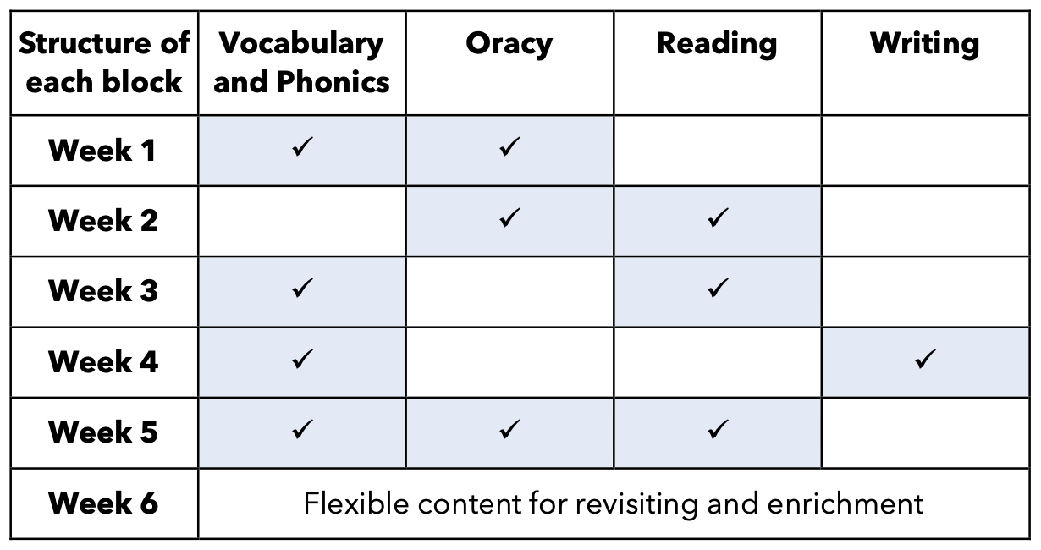

CUSP French has been purposefully built around the principles of evidence-led practice. This is to ensure that there is a focus on high-quality development of children as linguists. Core areas of study are revisited throughout the curriculum. Each unit of study focuses on phonics, grammatical structures, reading, writing, oracy and vocabulary. Fully resourced, CUSP French is both teacher facing and pupil facing, building consistency in how French is taught across the school and ensuring that teachers, including those with no prior knowledge of French, have the subject knowledge required to teach the content.
\
CUSP French has been designed to serve young linguists in the modern world. Key areas of focus have been deliberately selected to ensure that pupils are equipped with knowledge and language that will serve them in engaging with important and useful topics such as the environment, wellbeing and travel. The curriculum focuses not just on vocabulary acquisition but also on the building blocks of learning a new language.
Clear structures and learning routines underpin CUSP French. This allows pupils (and teachers) to direct their cognitive attention to the core content in each block. As with all CUSP subjects, Knowledge Notes are used to support instruction and the revisiting of new concepts. This strong focus on cognitive science provides the framework for pupils to deepen and broaden their knowledge of the French language and become confident, inspired linguists.
How is CUSP French organised?
CUSP French is taught from Years 3 – 6. Each year group has 6 blocks of 5 weeks teaching. Additional weeks in the academic year can be used for consolidation, revisiting or enrichment.
The curriculum is built to be delivered in 30 – 40 minutes of study per week. This can be organised as two shorter sessions (e.g. 2 x 15 – 20 minutes) or one longer lesson.
What will pupils know and be able to do at key points of the curriculum?
Each block includes study of key MFL linguistic concepts and previously
learnt language concepts to enable pupils to build on known themes and
vocabulary. The core content overview outlines the substantive and
disciplinary knowledge and key vocabulary that pupils will learn throughout each block of study. This includes the vocabulary, phonics and grammatical constructs that pupils will learn, as well as the opportunities to develop their reading, writing and oracy skills.
To note is that there is limited emphasis on pupils’ writing of French and a greater focus on reading, oracy and laying strong linguistic foundations. This is because pupils need to hear, see and say whole, correctly spelt words frequently before they are asked to apply these to written tasks.

