Slide 1

Welcome to Sharnford Church of England Primary School.
‘Many hearts make our school nourishing, flourishing and fruitful.’

Slide 2
Todays meeting
To give you an overview of the early years curriculum.
To find out how the school day will be organised.
To find out how you can support your child at home before starting school.
Practicalities – induction times, uniform, school meals etc.

Slide 3
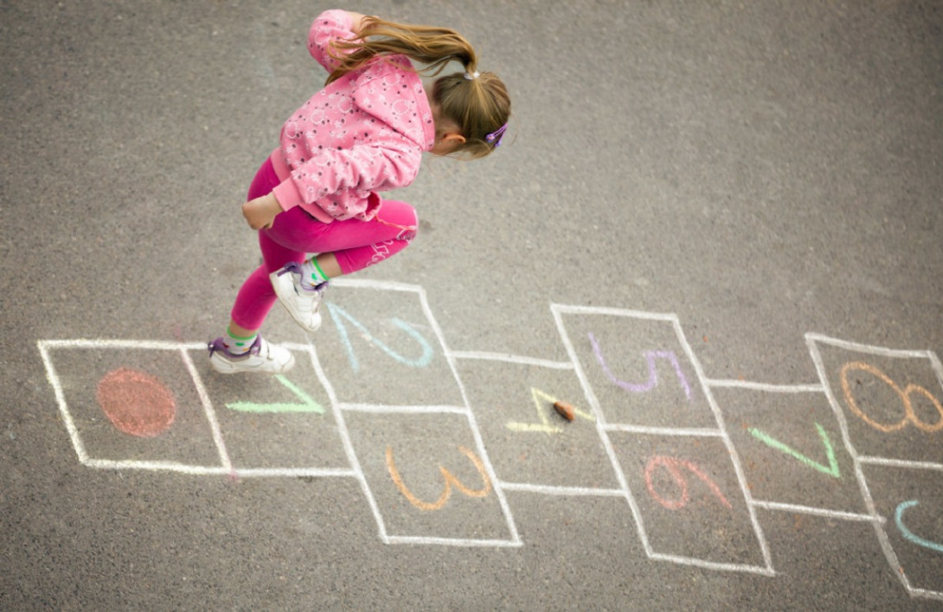
What is the Early Years Foundation Stage
( E.Y.F.S)?
The E.Y.F.S. is the stage of education for children from birth to the end of the Reception year.
It is based on the recognition that children learn best through play and active learning.

Slide 4
Early Years Curriculum
Activities in EYFS are carefully planned and organised in order to provide a range of learning experiences. Individual online records are kept by staff to record the activities your child participates in and undertakes, as well as their progress in specific skills. These will be shared with you through ‘Tapestry.’
Planning is carried out using a topic-based approach, following the children’s interests and responding to specific events.
There are 7 Areas of Learning in the Early Years Foundation Stage (EYFS), which activities are planned around:
Personal, Social and Emotional Development
Physical Development
Communication and Language
Literacy
Mathematics
Understanding the World
Expressive Arts and Design
Throughout the EYFS, children will be working towards the Early Learning Goals. These describe the level of attainment expected at the end of your child’s reception year in school.

Slide 5

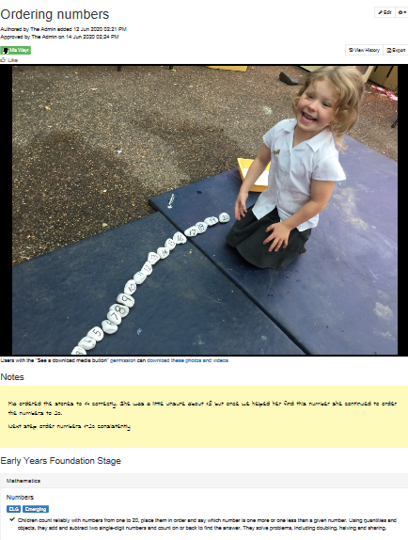
Tapestry
Online journal of your child’s learning.
Communicates learning in school and at home.
You will have received an email via Arbor. There is a consent form to activate your child’s journal. A further form must be completed if more than one parent would like to receive Tapestry.

Slide 6
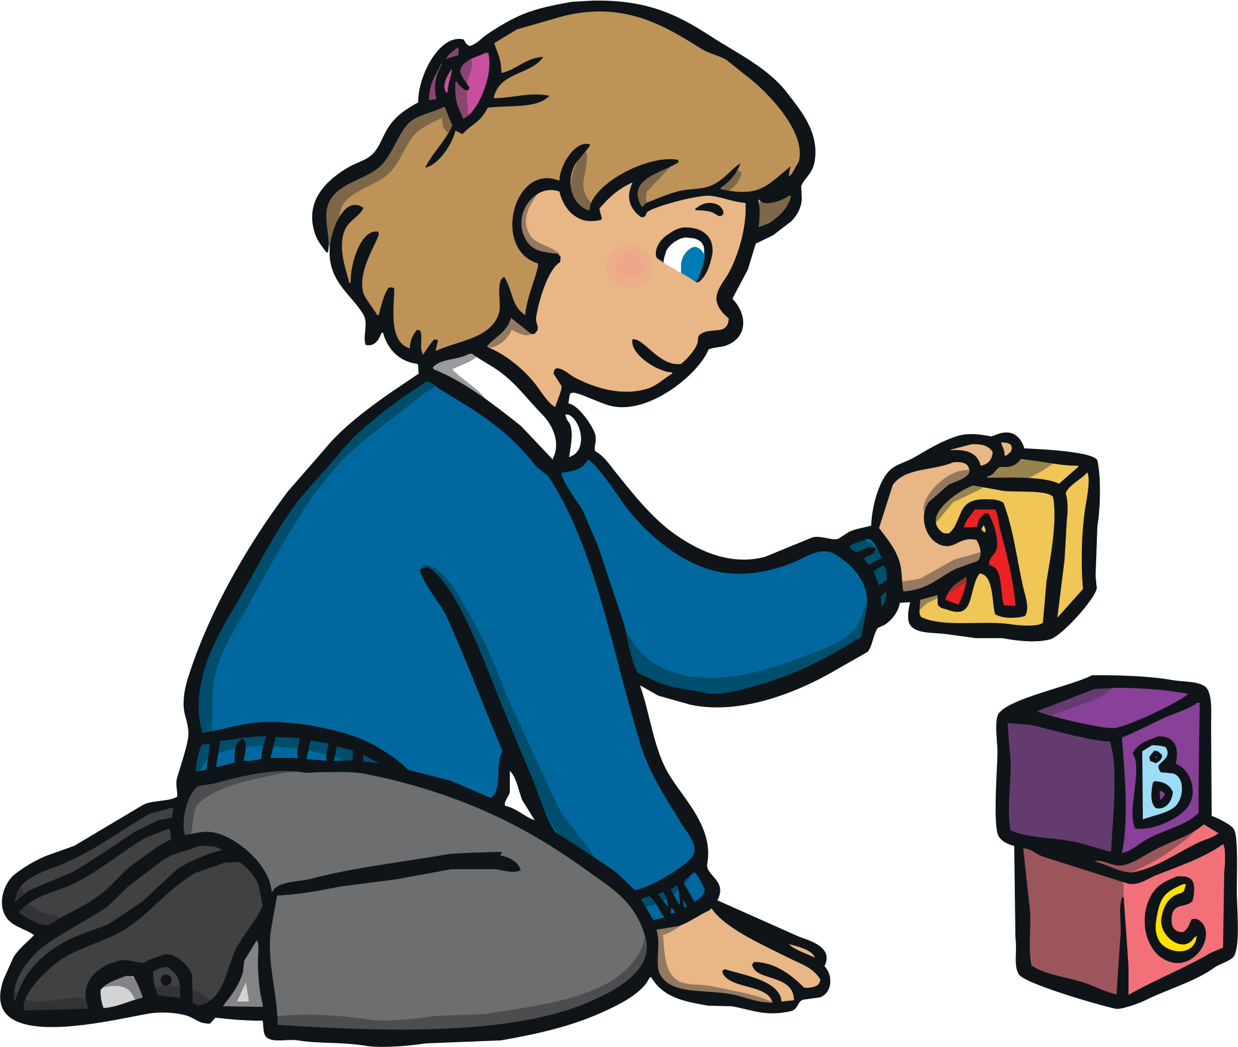
Reception Baseline Assessment
This is a statutory assessment for all reception children in the country, covering Literacy, Communication & Language and Maths. It comprises short, practical activities for the children to complete with their teacher. The children will not be aware that they are completing an assessment and it is not something that they can prepare for in advance, so please do not worry!
It is used to measure progress between entering reception and leaving year 6.

Slide 7

Home Learning
We understand and value the support you provide for your child at home. Early years staff would love to hear about what you and your child have been doing at home. We encourage you to share your child’s learning, achievements and experiences with staff through ‘Tapestry’, as this helps us to build a more complete picture of your child and we can share any achievements with the rest of the class.
Homework – Your child will be given a reading book and sounds/words to learn within the first few weeks of starting school. Please share these books and sounds on a daily basis.
The initial reading books your child receives will not have words.
Please spend time using the pictures to share vocabulary and encourage
your child to describe what is happening on each page.
Share a range of books with your child on a regular basis.

Slide 8


Slide 9
What can you do to help your child?
Share lots of books, talking about the pictures and characters. Re-read favourites
Encourage children to talk, talk, talk
Reading keywords (own name, labels, shop signs)
Encourage mark making e.g. shopping lists, notes
Practise counting at any time-climbing the stairs, toys, food etc. Go on number hunts
Play simple board games
Sing number rhymes and songs together
Play eye spy with my little eye game
Playdough, scissors, threading, Lego
Getting dressed, toileting, handwashing

Slide 10
A typical day in our Foundation Class…
8.45 Welcome and register
9.00-9.15 Assembly gradually introduced
9.20-10.30 Daily phonics and literacy
10.30 – 11.00 Snack and break time
11.00-12.00 Mathematics directed group work and free flow
12.00-1.00 Lunch
1.00-2.50 Other areas of the curriculum P.E/ UW /Creative R.E
2.50 Tidy away, story and Home Time at 3.15pm

Slide 11

Uniform
Uniforms can be ordered via ‘Hole in the Wall’ in Hinckley.

Slide 12
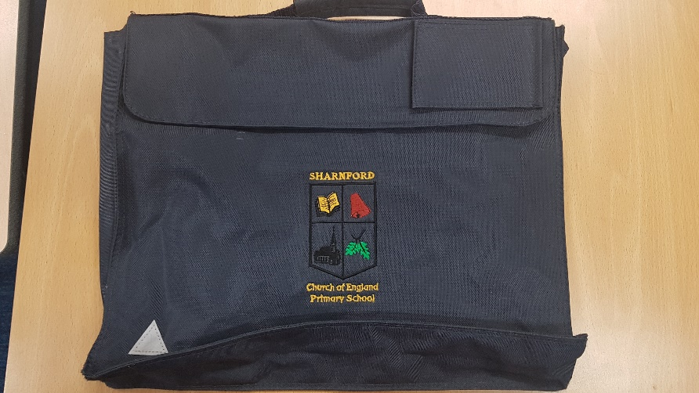
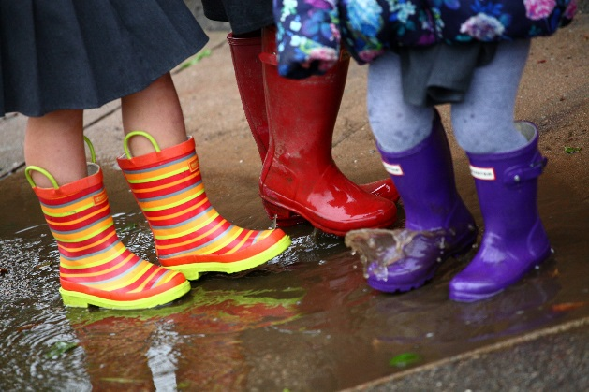
Free book bag in school every day
P.E. kits to be worn on days we teach P.E. white t-shirt, black shorts, P.E pumps and trainers for outdoors. We will let you know which days nearer the time.
Please ensure that names are in EVERYTHING!!!
Send coats EVERYDAY.
Wellies and waterproofs can be left in school.
Sensible shoes and no jewellery please.

Slide 13
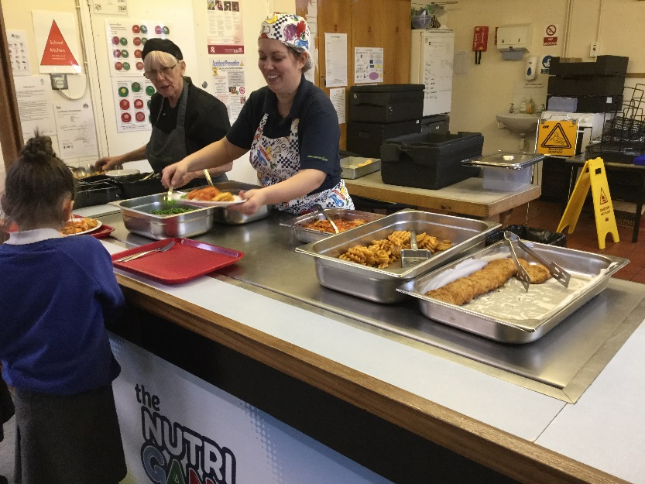
Free school meals for all.
How to Order
You will need to respond to
an email which will be sent
to you soon.

Slide 14


Slide 15



Milk registration
https://www.coolmilk.com
Free fruit for snack

Slide 16

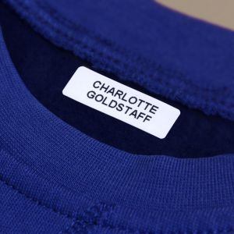
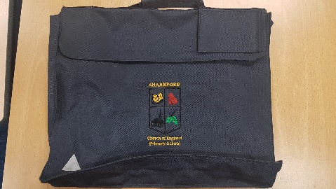

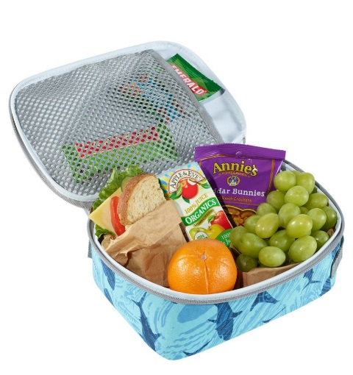
The First Few Days ...
All clothing named!
Free milk for 4 years olds
Book bag everyday
Free fruit in the morning
Water bottle
Lunch boxes or hot school dinner

Slide 17
Other matters…
Please let us know if someone different is collecting your child!
Parent Helpers always welcome – Must fill in a CRB
Medical
Any sickness, diarrhoea, must be followed by at least 48 hours absence.
Head lice are common! Please check regularly and treat as recommended.
Any absence requires a telephone call to the school office by 9:00am
Any prescribed medication can only be administered by prior arrangement with the school office

