Slide 1
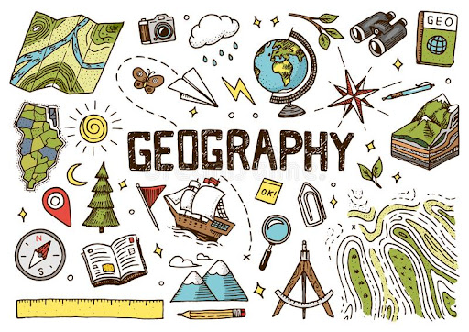

GEOGRAPHY
The study of where places are found, what they are like and the relationships between people and their environments.

Slide 2
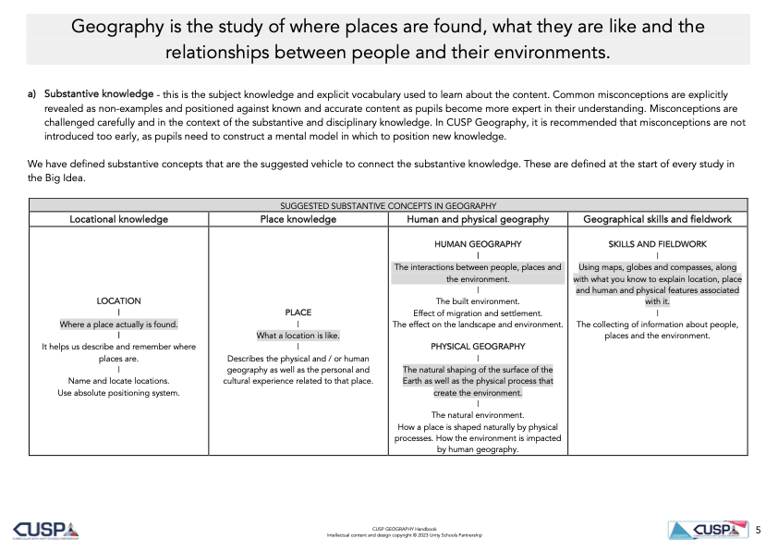

Slide 3
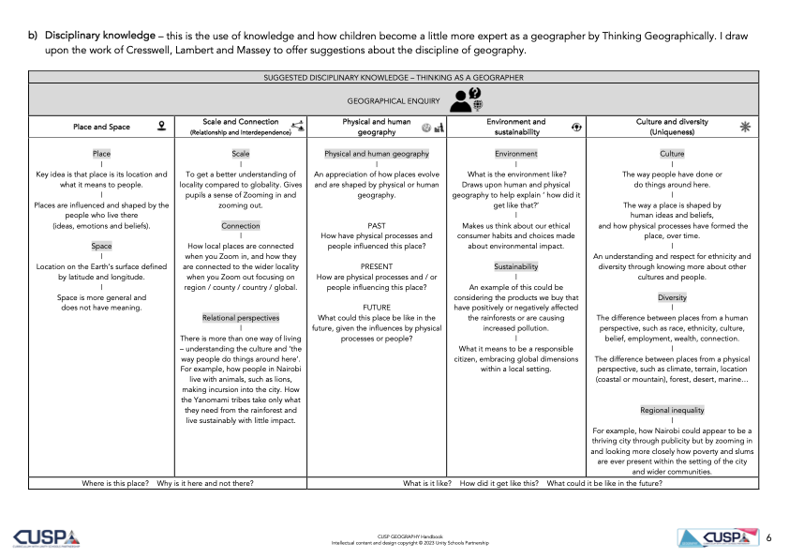

Slide 4
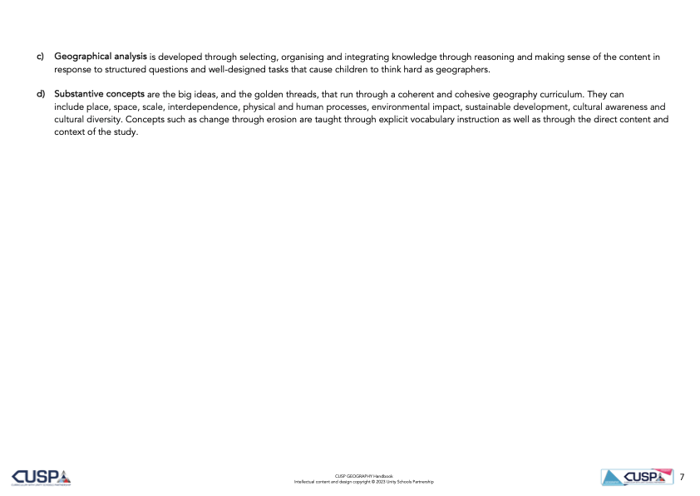

Slide 5


