Slide 1







hazel CLASS
SHARNFORD
Primary School
Information Evening

Slide 2





CURRICULUM To Be Covered Autumn TERM
History- Anglo-Saxons, Scots and Vikings
Geography- Rivers, latitude and longitude
Science- Living things and their habitats. States of Matter
Maths- Place Value, addition, subtraction, multiplication, division, measurement and area.
Reading- The Queen’s Nose
The Raven
The Girl who Stole an Elephant
Art- Drawing and painting
DT- Food and nutrition, mechanisms
English- A range of fiction and non-fiction texts.
A variety of writing skills, using different sentence types.
A selection of core texts.

Slide 3



CLASS RULES
1) BE READY
2) BE RESPECTFUL
3) BE SAFE
Consequences:
Warning
Move spaces
Calm time
move class/quiet area elsewhere
Loss of break
Rewards:
Persistent poor behaviour:
Verbal praise
Stickers/stamps/pompoms
Written comments
Wow work board
Certificates
Star of the week certificate
Contact parents
Meetings to decide next steps
Behaviour Plan

Slide 4


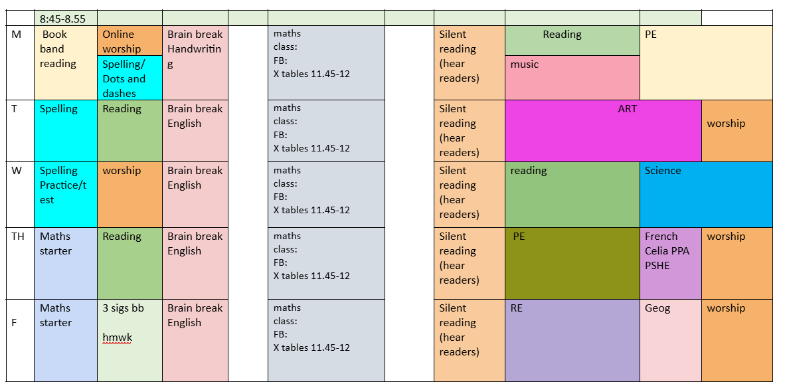



A TYPICAL WEEK

Slide 5
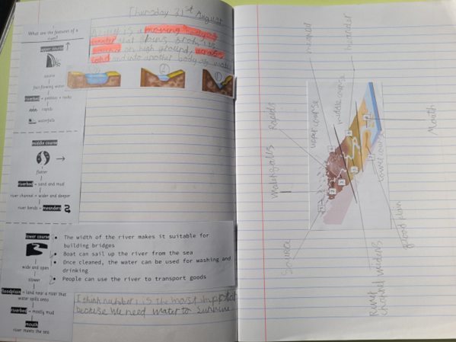
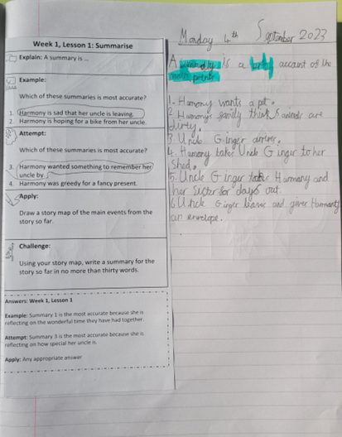
A TYPICAL WEEK
CUSP Curriculum
  "Thinking hard"

Slide 6



  HW will be given out on a Friday (this includes spellings) and will be handed in on a Thursday
  Homework also includes reading at home at least 3x a week
  PE is on a Monday and Friday afternoon (correct PE kit to be worn, no jewellery)
  Reading record and books go home every week- these are checked every Friday
rOUTINES
for class

Slide 7
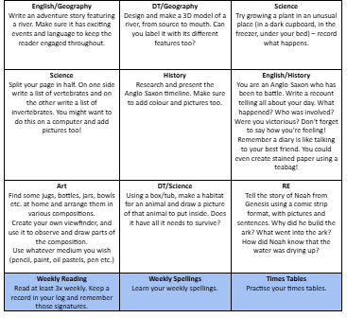
Compulsory:
  Spellings
  Maths/English activity sheet
  reading 3 x week (must be 1 book band book)
Optional:
  Homework grid (1 per week)
Stamps given for exceptional homework
Homework

Slide 8
  The children are to keep water bottles by the sink.
  They have access to a drink at all times
  Must be water or flavoured water in the classroom (cups are free to use if they don't have one)
  Juice is for lunch and break times.
Water bottles

Slide 9

Curriculum Newsletter
Website Curriculum Info:
Emails
We can be contacted via the office email.
https://www.sharnfordprimaryschool.com/
COMMUNICATION
In Person
Quick Notes
We are usually outside the gate each morning/afternoon – if you need to see us in private please make an appointment through Mrs Proctor.
These can be dropped to us via your child.

Slide 10
COMMUNICATION CONTINUED
Your Concerns
Our Concerns
Please come to us if you have any concerns about your child – academically or socially - the sooner the better!
If we have concerns about your child’s progress or social development we will make a point of asking for a meeting so we can have common targets to work towards.

Slide 11


HOW YOU CAN HELP...
  Support their homework tasks (topic based, Maths, Times tables, spellings)
  Curriculum support - books, CGP, online games, BBC bitesize...
  Encourage reading – at least 10 mins every other day
  Ensure they arrive at school on time (8:45).
  Let us know if there is a reason your child can’t do PE
  Correct school and PE uniform

Slide 12


Thank
You
If you have any questions, please feel free to speak to me privately

