Slide 1




Redwood Class
Meet The Teacher

Slide 2




Behaviour
Rewards –praise, stamps, pom poms, class treats, written comments, recognition board, notes home & Achievement Certificates

Slide 3
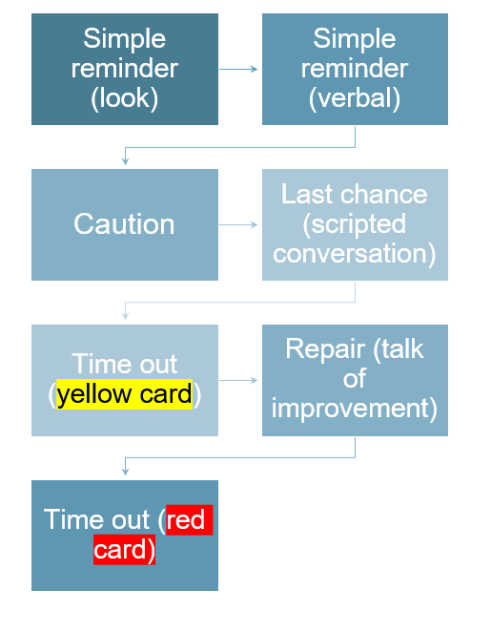
Persistent poor behaviour – we then contact parents/
carers and we meet to decide the next steps together.

Slide 4
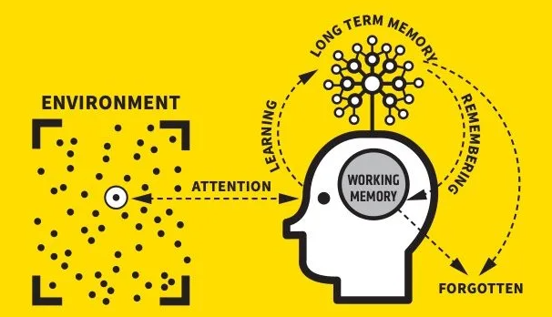

CUSP curriculum is guided by evidence-led curriculum structures, such as retrieval, spaced retrieval practice and interleaving. It is underpinned by explicit vocabulary instruction and research-focused pedagogy to enable children to be effective learners.
Notes:
Willingham’s model of the mind - cognitive science

Slide 5

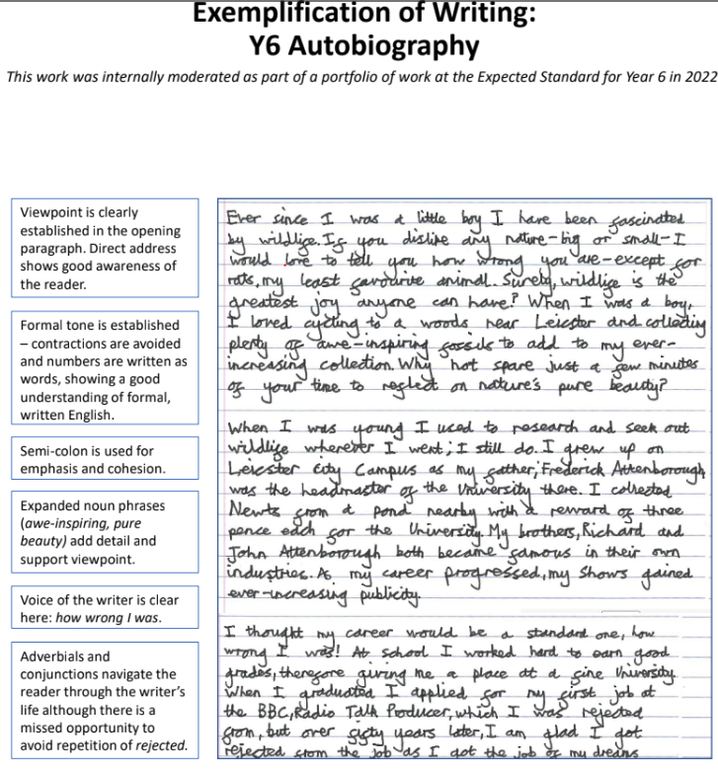




Slide 6
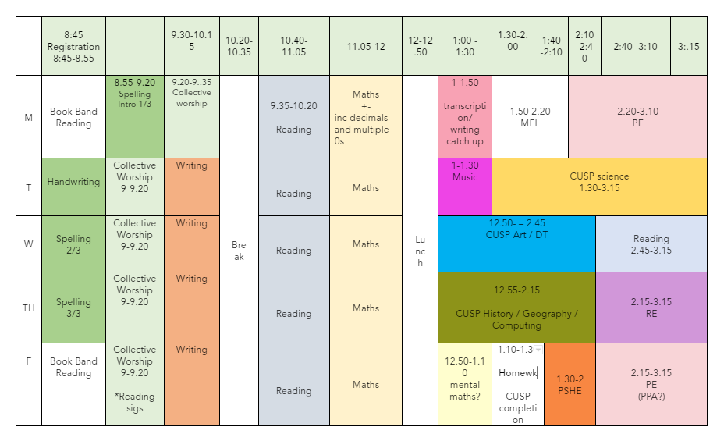
A Typical Day…..
However – meetings are unavoidable at times so we will have Mrs Morgan to help cover…..

Slide 7

Homework & Reading
Homework is to be handed in on a Thursday and will be handed back out on a Friday
Homework is weekly and consists of a maths or English activity, times tables, spellings and reading at home at least 3x week.
Reading Record and books go home. They are checked in school on a Friday.

Slide 8
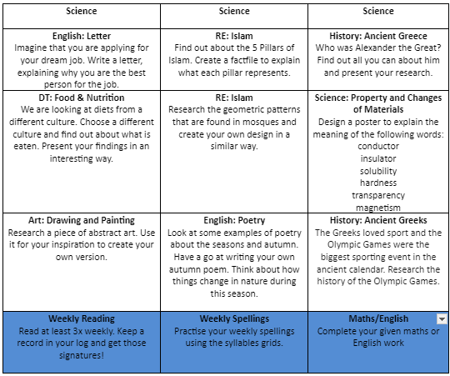
Be creative
Encourage research & curiosity
The 9 tasks on this grid are optional extra homework ideas.
A copy of the homework will be posted on the website.
The homework will support ongoing work and provide opportunities to share classroom learning.

Slide 9
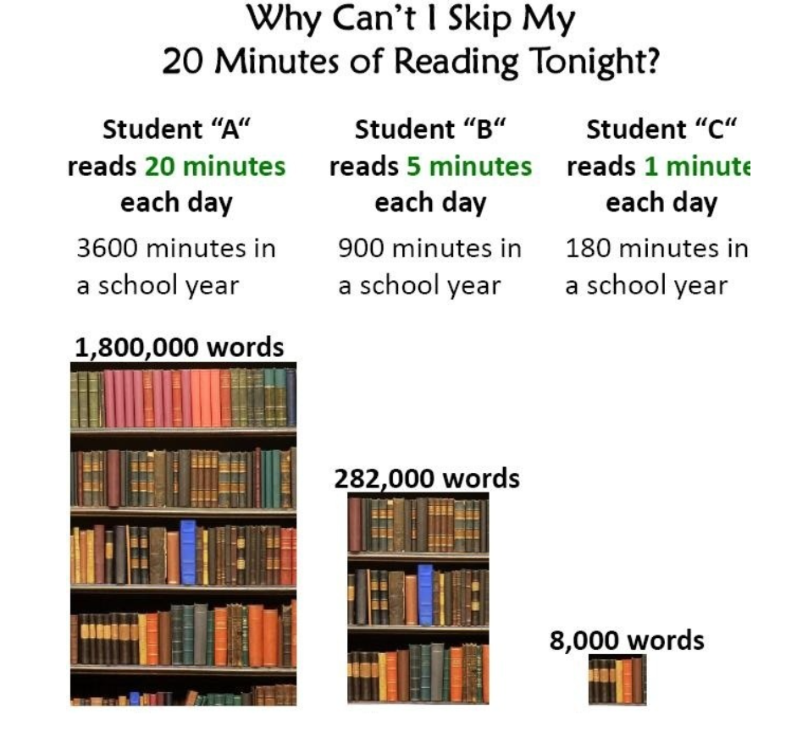
The importance of reading..

Slide 10
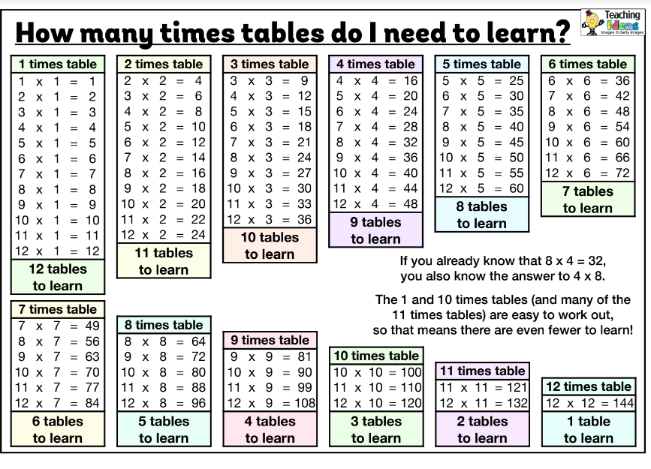
Times Tables

Slide 11


P.E
Every Monday and Thursday – please ensure children come in the appropriate kit - no colours that are not white and navy/black
We have PE outside and inside so the children will need long trousers and a long sleeved top in the school colours.
Please ensure hair is tied back and no jewellery. Earings out or taped up. - please provide your child with tape.

Slide 12

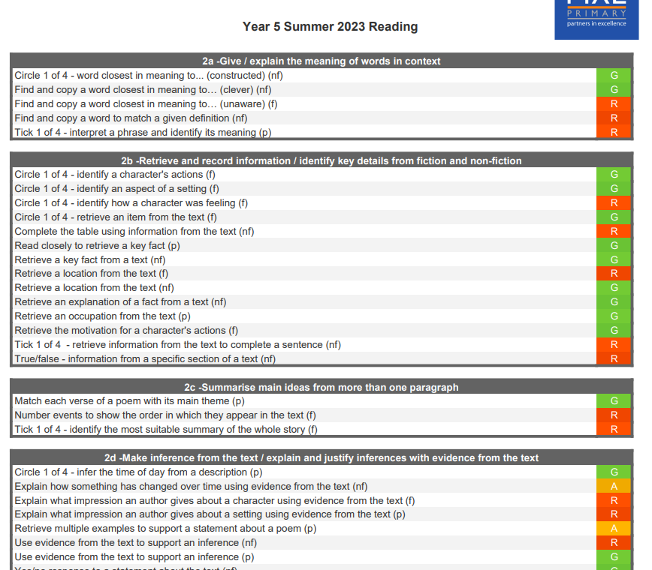
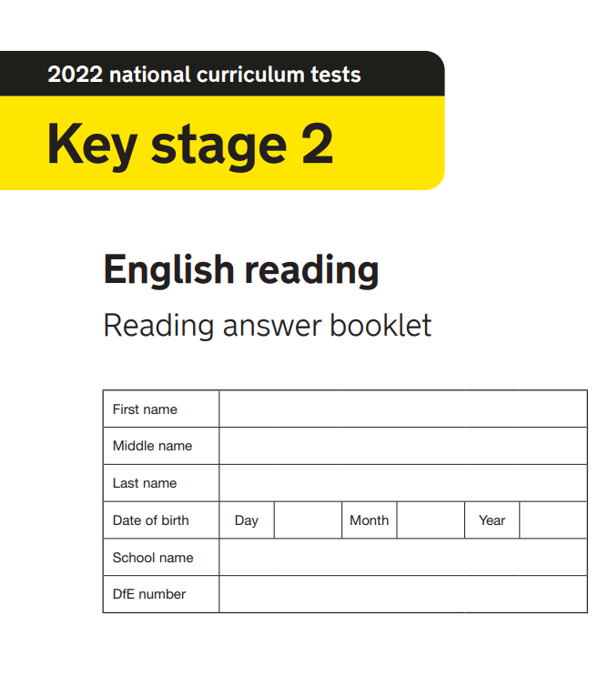
Assessment

Slide 13
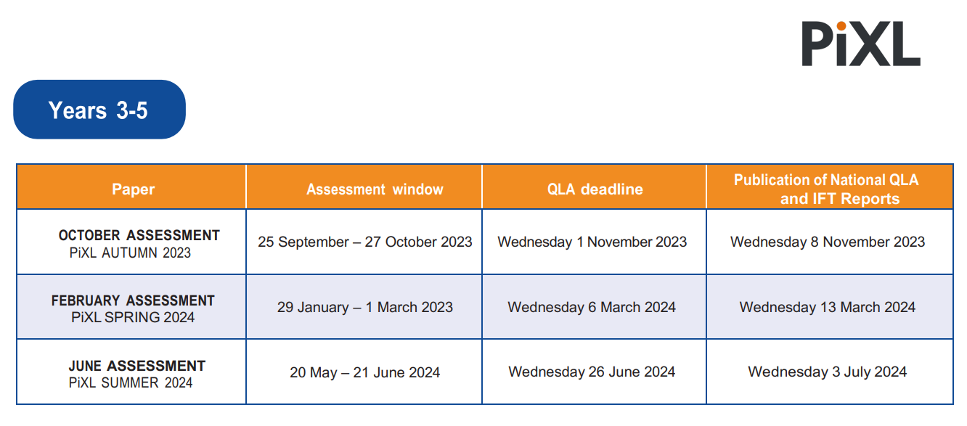
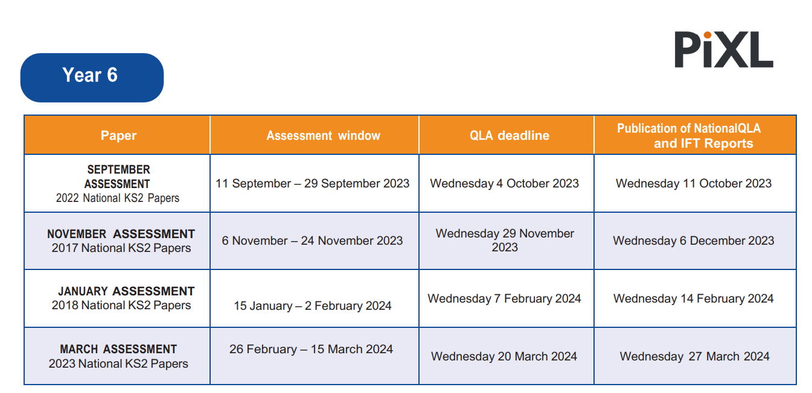
Y6 SATs meeting for parents/carers will be in Feb 2025.
SATs week is 12th-15th May.

Slide 14



Communication
Website: https://www.sharnfordprimaryschool.com/
Facebook
Curriculum Newsletter
Emails: We can be contacted via the office email. We will communicate via email the majority of the time so please check them daily.
Please come to us if you have any concerns about your child – academically or socially - the sooner the better! Equally, if we have concerns about your child’s progress or social development we will make a point of asking for a meeting so we can have common targets to work towards
We are usually outside the gate each morning/night – but if you need to see us in private please make an appointment through Mrs Proctor
Quick notes can be dropped to us via your child.
Wellbeing- please contact us if you feel your child is struggling with any issues such as anxiety, stress or any mental health issues.

Slide 15


How to help.........

